Slide 1
Control statements: Loop
Introduction To programming
Shubham Dhungana

Slide 2
Loop
Repetition of Statements until the condition is met (true)
While
Do while
For
For and while are pretest loops, and the
Do while is a post-test loop

Slide 3
For Loop
for (initializationStatement; testExpression; updateStatement)
{
// statements inside the body of loop
}

Slide 4
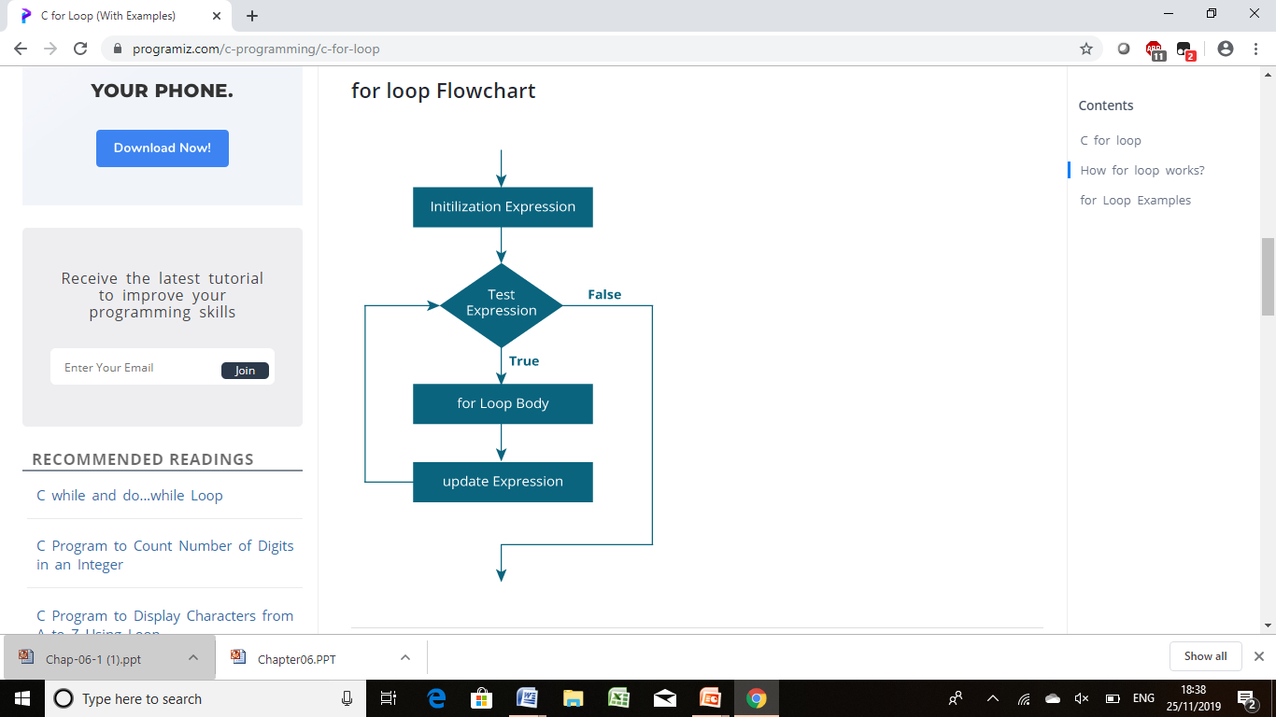

Slide 5
While loop
while (testExpression)
{
// statements inside the body of the loop
}

Slide 6
Do while loop
The do..while loop is similar to the while loop with one important difference. The body of do...while loop is executed at least once. Only then, the test expression is evaluated.
do
{
// statements inside the body of the loop
}
while (testExpression);

Slide 7
Terminating loop
Counter-controlled loops - a loop controlled by a counter variable, generally where the number of times the loop will execute is known ahead of time.
Event-controlled loops - loops where termination depends on an event rather than executing a fixed number of times

Slide 8
Example of: Counter-controlled loops
// Print numbers from 1 to 5
#include <stdio.h>
int main()
{
int i = 1;
while (i <= 5)
{
printf("%d\n", i);
++i;
}
return 0;
}

Slide 9
Example of: Event-controlled loops
// Program to add numbers until the user enters zero
#include <stdio.h>
int main()
{
double number, sum = 0;
// the body of the loop is executed at least once
do
{
printf("Enter a number: ");
scanf("%lf", &number);
sum += number;
}
while(number != 0.0);
printf("Sum = %.2lf",sum);
return 0;
}

Slide 10
Break Statement
The break statement ends the loop immediately when it is encountered.
Syntax:
break;

Slide 11
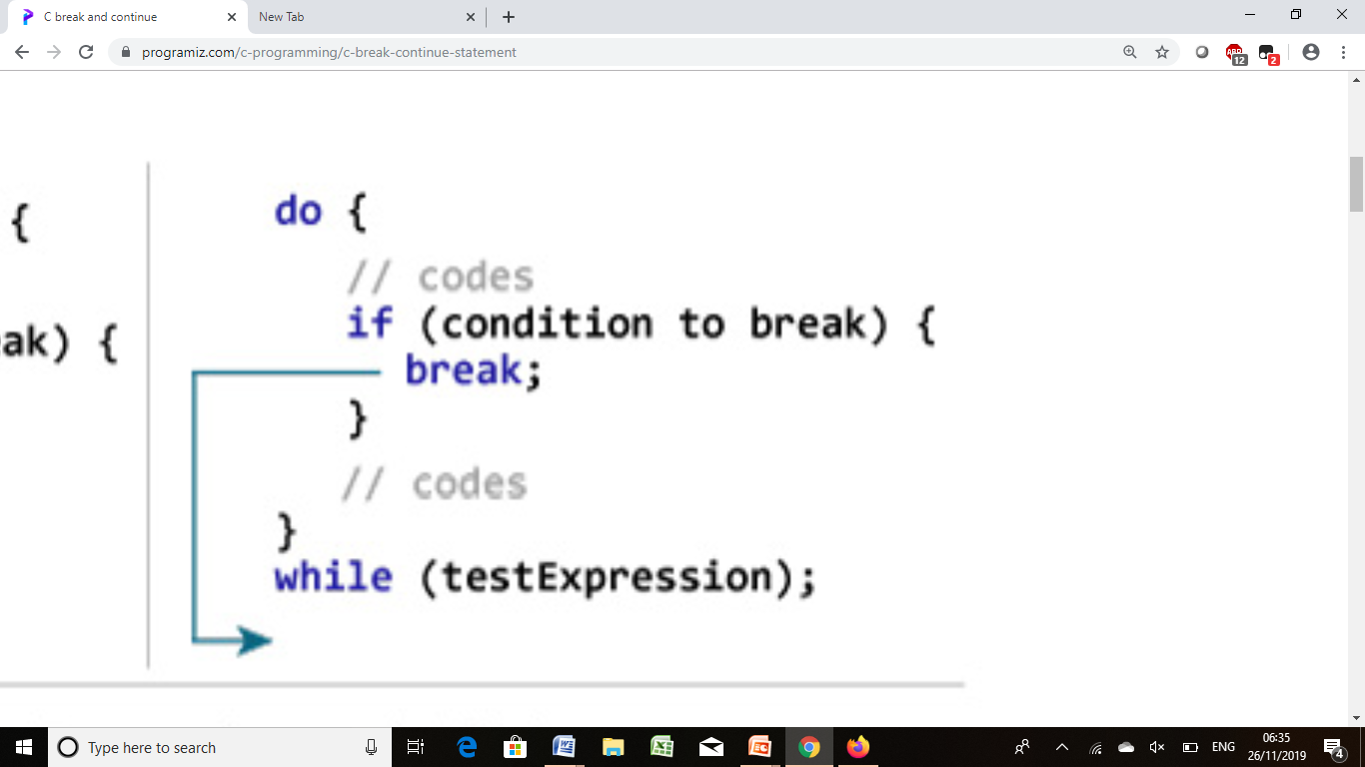
Break in do while

Slide 12
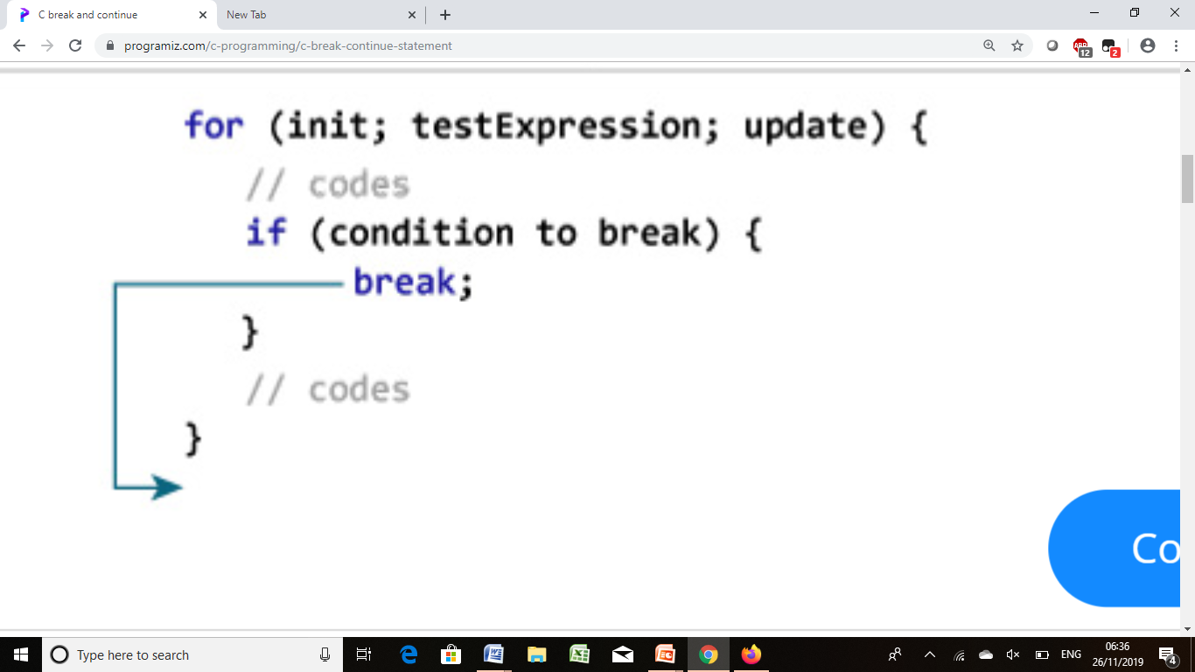
Break in for

Slide 13
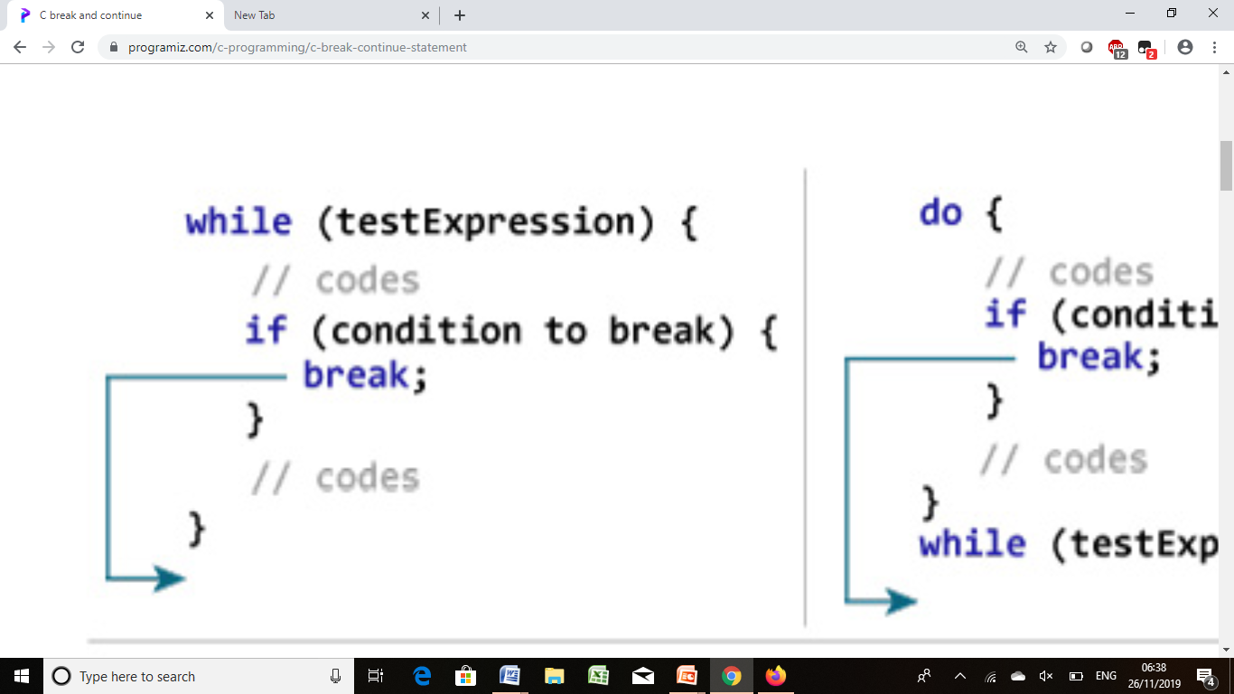
Break in while

Slide 14
Continue Statement
The continue statement skips the current iteration of the loop and continues with the next iteration.
Syntax:
continue;

Slide 15
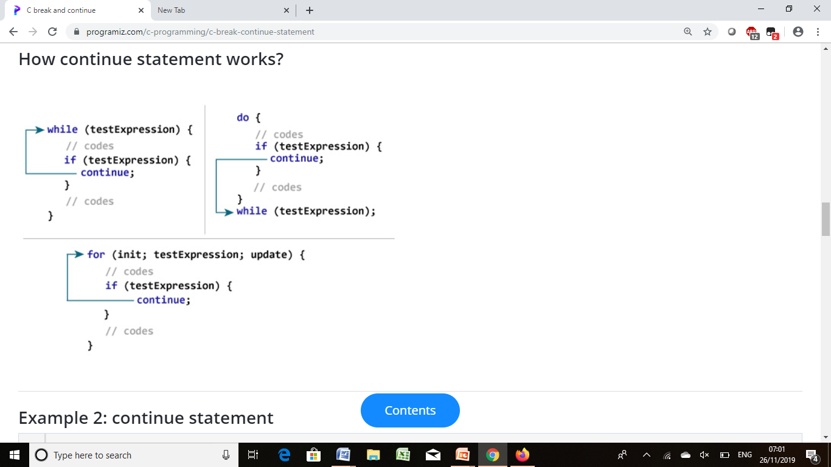
How to use Continue

